Slide 1
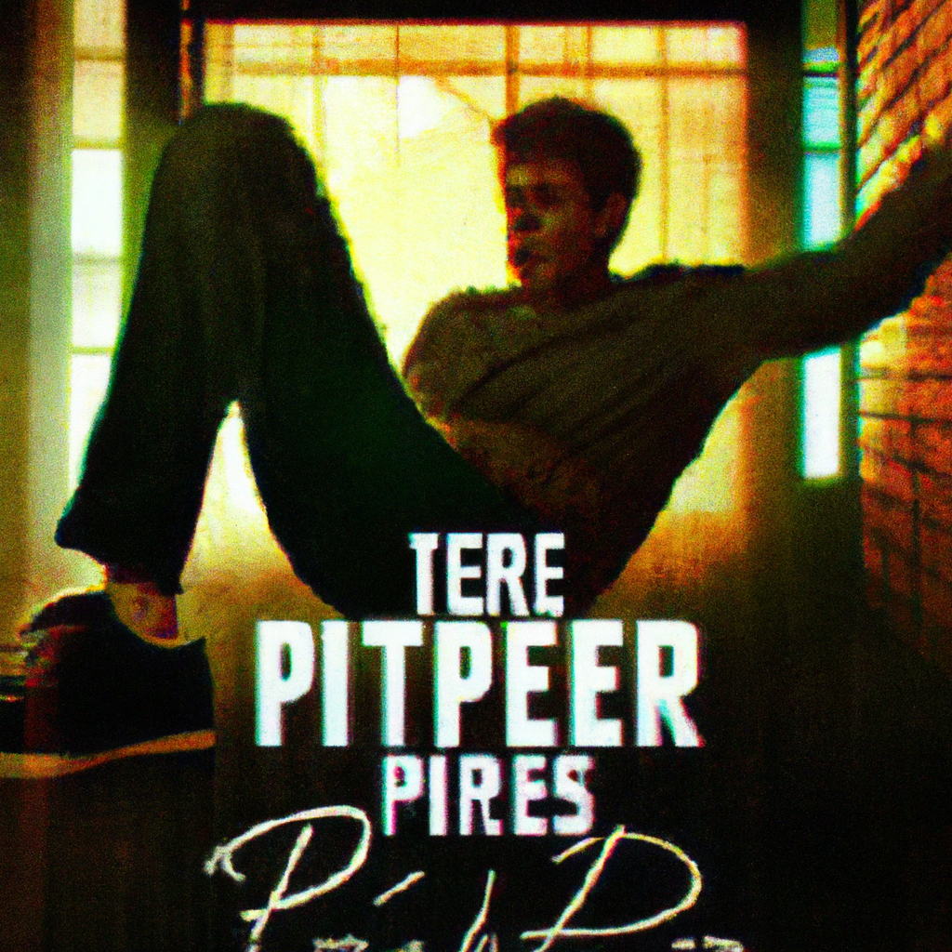
"Peter Parker: The Pre-Spiderman Chronicles - Rise of a School Nerd"
Panel 1: A close up of an alarm clock reading '6:30', buzzing loudly. A hand slaps down on the snooze button, silencing it.
Panel 2: A teen boy, Peter, sits up in bed, yawning and stretching. He reaches for his glasses on the nightstand.
Narrator: "This here is Peter Parker, your typical high school science nerd."
Panel 3: View from the hallway. A woman's voice calls out, "Peter, it's time to wake up and get ready for school!"
Peter: "I'm already awake, Aunt May."
Narrator: "Peter lives with his Aunt May and Uncle Ben. They've raised him ever since his parents died in a plane crash."
Panel 4: Peter, now dressed in his school clothes, comes down the stairs. He greets his aunt and uncle in the kitchen.
Panel 5: Peter sits at the kitchen table and excitedly talks about a school field trip to one of the ESU labs. His aunt and uncle listen while eating their breakfast.
Narrator: "Peter's a bit of a science whiz. He's been looking forward to this field trip for weeks."
Panel 6: Peter finishes his breakfast and leaves the house. He walks a few blocks to the bus stop.
Narrator: "Just another ordinary day for Peter Parker. Little did he know, this was just the calm before the storm."
Panel 7: Peter gets on the school bus, it drives off.
Narrator: "And so begins the story of how Peter Parker became the Miraculous Spiderman."

Slide 2
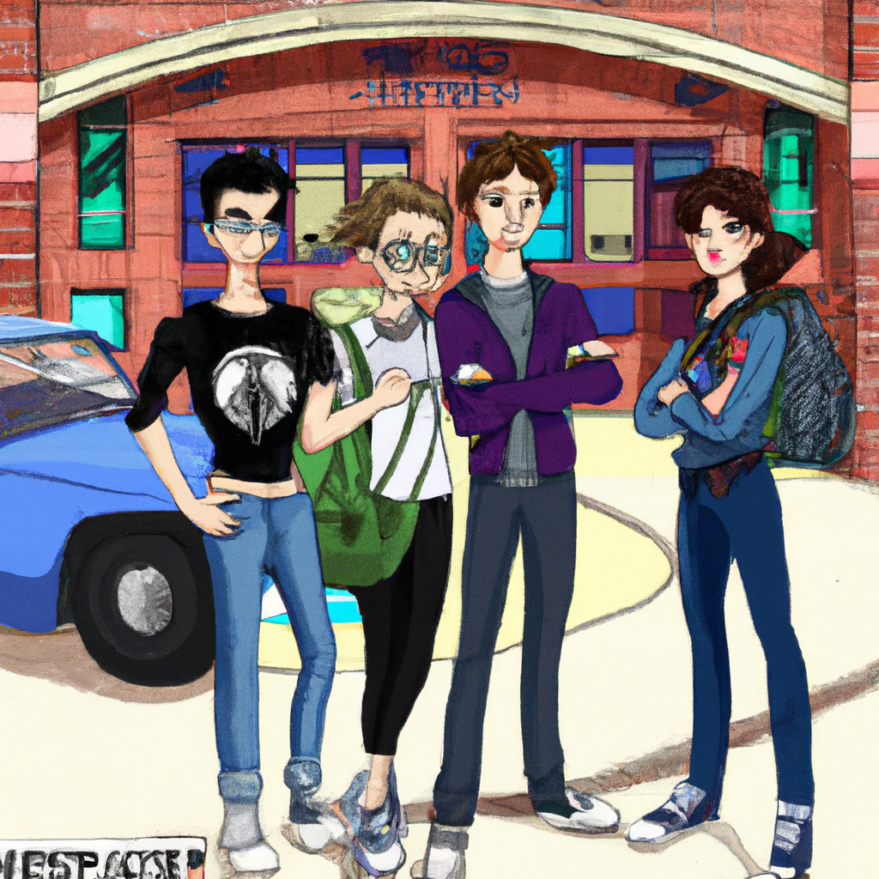
"Collision Course: Midtown High School"
Panel 1: A bustling scene of Midtown High School. A bus has just pulled up in front of the main entrance where a sign reads 'Welcome to Midtown Magnet High School'.
Panel 2: The bus doors swing open and teenagers pour out. Last to exit is Peter, who looks up at the school, a little apprehensive.
Panel 3: Harry and Liz are waving at Peter. Harry is taller than Peter with jet black hair and blue eyes, wearing a dark blue sweater vest with jeans. Liz is the same height as Peter, sporting short brown hair, glasses, and a light blue t-shirt with a cat.
Panel 4: The trio are talking excitedly about their upcoming trip to ESU. Liz is especially excited about the lab tour and Harry mentions the great researchers they'll meet.
Panel 5: Suddenly, a football hits Peter in the back of the head, knocking off his glasses. He yells in surprise.
Panel 6: There's a group of laughing kids who are known as the 'in crowd'. They're led by Flash Thompson, a tall, muscular teenager wearing a Letterman's jacket, who is obviously amused at hitting Peter with the ball.
Panel 7: Liz confronts Flash, accusing him of purposely hitting Peter with the football. Flash mocks her, dismissing the claim and making fun of Peter's reflexes.
Panel 8: Harry steps in, asking Flash why he can't leave Peter alone. Flash challenges Harry, asking what he's going to do about it while a blonde cheerleader, Gwen Stacy, mockingly suggests Harry's father might fire Flash's father.
Panel 9: Flash gets in Harry's face, grabbing him by the collar and asking sarcastically if his father is going to sue him. The tension is palpable.

Slide 3
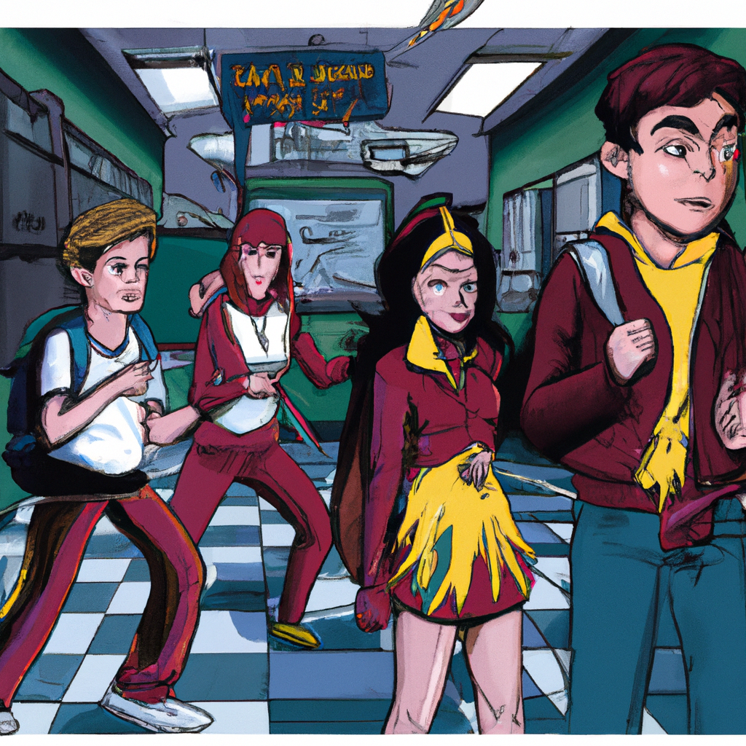
"High School Heroes: Rise Against the Bullies"
FRAME 1: The school bell rings loudly, BRRRING! The hallways are bustling with students heading to their first class.
FRAME 2: Peter, Harry, Liz, and a group of popular students known as the In Crowd are the only ones left behind in the hall. Flash, the leader of the In Crowd, roughly lets go of Harry.
FRAME 3: Close-up on Flash as he smirks, "Just be glad class is about to start. I can't risk another detention, especially with summer a few months away. I'll catch you geeks later! Especially you, Parker."
FRAME 4: Flash shoves Peter in the chest, who stumbles backwards and falls onto the floor. The In Crowd breaks into laughter.
FRAME 5: The In Crowd, still chuckling, turn their backs on Peter, Harry, and Liz, and saunter away.
FRAME 6: Gwen, a member of the In Crowd, throws a final insult over her shoulder. "Later, losers!" she laughs.
FRAME 7: Close-up on Harry's face. He mutters "Assholes!" under his breath, once they're out of earshot.
FRAME 8: Harry extends a hand to Peter, helping him up. "You ok, buddy?"
FRAME 9: Peter dusts himself off, shrugs, "I'm good. Just glad he didn't give me a black eye this time."
FRAME 10: Liz approaches them, holding Peter's glasses. "I sure wish there was something we could do about those guys," she says, handing the glasses to Peter.
FRAME 11: Close-up on Peter's face. "Thanks, Liz," he says appreciatively, and puts on his glasses.
FRAME 12: Liz smiles sweetly at Peter. "Don't mention it."
FRAME 13: Harry checks his watch. "Come on, we better get to class before we're late."
FRAME 14: The three friends head towards the school building, leaving the empty hallway behind.

Slide 4
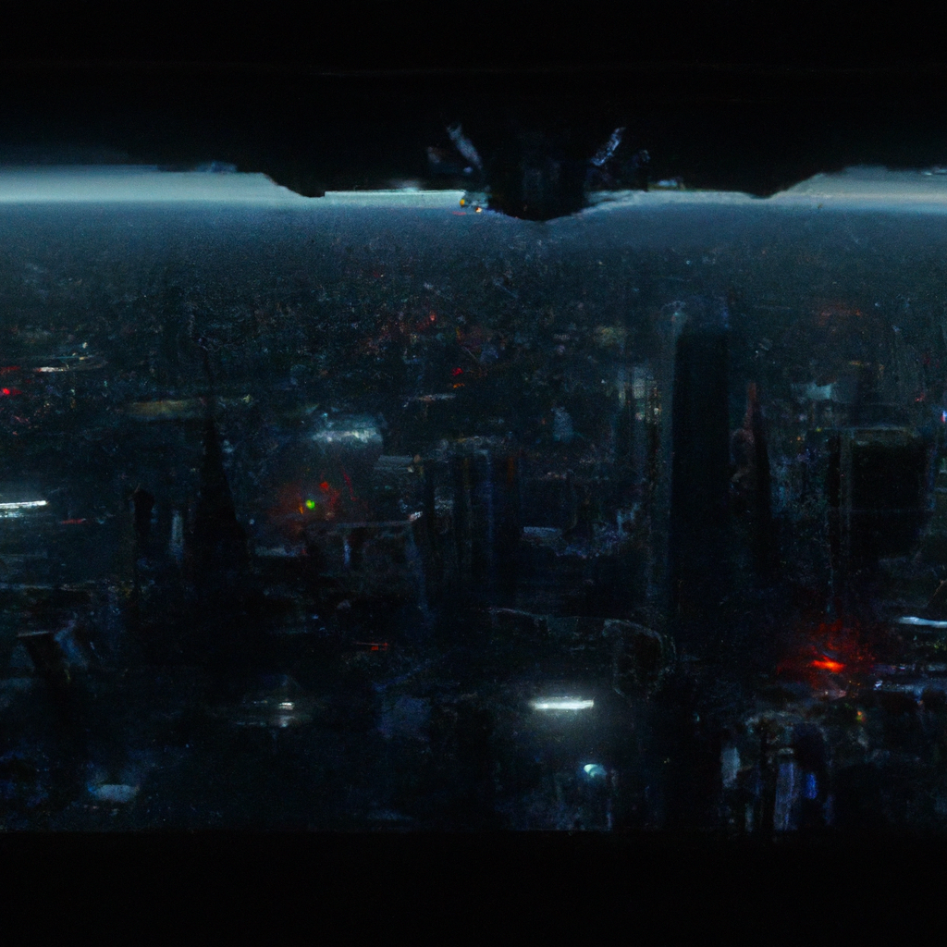
"Ground Zero: The Oscorp Experiment"
Panel 1: Wide shot of Manhattan, showing a tall 80-story building with OSCORP INDUSTRIES written at the top.
Panel 2: Inside the top floor office, a man is sitting at his desk working. There's a knock on the door.
Panel 3: The man answers, "Come in". The door opens, revealing a woman who seems to be his secretary.
Panel 4: She tells him, "Mr. Osborn, Dr. Tombs is ready to proceed with the new Tech flight testing." He instructs her to tell Dr. Tombs that he'll be down soon.
Panel 5: A closer look at the man, Norman Osborn. He's in his early to mid-forties, well-dressed, clean shaven, with reddish brown hair and green eyes.
Panel 6: Norman Osborn exits the elevator into a laboratory. There's a platform surrounded by scientists in lab coats.
Panel 7: Norman talks to one of the scientists, Adrian Tombs, an older man in his late forties with dark gray hair.
Panel 8: Tombs tells Osborn they're ready to begin. Osborn gives the go-ahead and a man in green body armor stands next to a glider.
Panel 9: The test pilot presses buttons on his wrist as the glider starts to hover above everyone.
Panel 10: Tombs asks Osborn what he thinks. Osborn says it's better than last time but they still need to do more tests before presenting to the military.
Panel 11: Norman then speaks with another scientist, Dr. Mendell Strom, discussing the progress on the OZ formula.
Panel 12: They enter a room full of shelves with vials containing a green liquid substance, each labeled 'OZ-003'.
Panel 13: Dr. Strom begins testing the OZ formula on two white rats in a specialized container.
Panel 14: The rats react badly, their eyes become bloodshot, their fur turns gray, they become deranged and start attacking each other.
Panel 15: Norman and Dr. Strom look on in horror as the rats kill each other. Norman demands an explanation but Dr. Strom is clueless.
Final Panel: Norman orders Dr. Strom to figure out what went wrong and leaves the room, leaving Dr. Strom alone in the lab.

